Slide 1


Capstone Project – 3 Classification Mobile Price Range Prediction
BY
SAI NARASIMHA CHARAN THULASI

Slide 2
Problem Statement
In the competitive mobile phone market companies want to understand sales data of mobile phones and factors which drive the prices. The objective is to find out some relation between features of a mobile phone(eg:- RAM, Internal Memory, etc) and its selling price. In this problem, we do not have to predict the actual price but a price range indicating how high the price is.

Slide 3
WORK FLOW:
Data Collection and Understanding
Data Cleaning and Manipulation
Exploratory Data Analysis
ML Model
Implementation
Feature engineering
And Data Preprocessing
Hypothesis
Testing
So we divide our work flow into following steps

Slide 4
Data Summary
Battery_power - Total energy a battery can store in one time measured in mAh.
Blue - Has bluetooth or not.
Clock_speed - speed at which microprocessor executes instructions.
Dual_sim - Has dual sim support or not.
Fc - Front Camera mega pixels.

Slide 5
Four_g - Has 4G or not.
Int_memory - Internal Memory in Gigabytes.
M_dep - Mobile Depth in cm.
Mobile_wt - Weight of mobile phone.
N_cores - Number of cores of processor.

Slide 6
Pc - Primary Camera mega pixels.
Px_height - Pixel Resolution Height.
Px_width - Pixel Resolution Width.
Ram - Random Access Memory in Mega.
Touch_screen - Has touch screen or not.
Wifi - Has wifi or not.
Sc_h - Screen Height of mobile in cm.
Sc_w - Screen Width of mobile in cm.
Talk_time - longest time that a single battery charge will last when you are.
Three_g - Has 3G or not.
Wifi - Has wifi or not.
Price_range - This is the target variable with value of 0(low cost), 1(medium cost),2(High Cost),3(Very High cost).

Slide 7
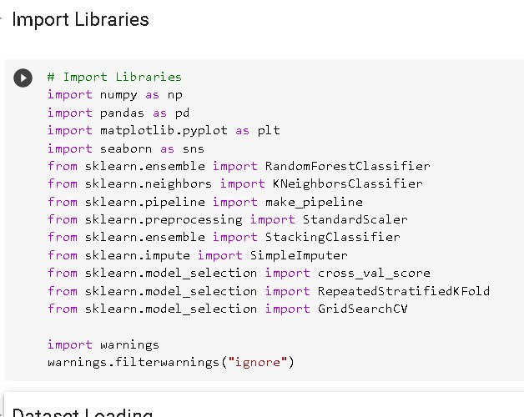
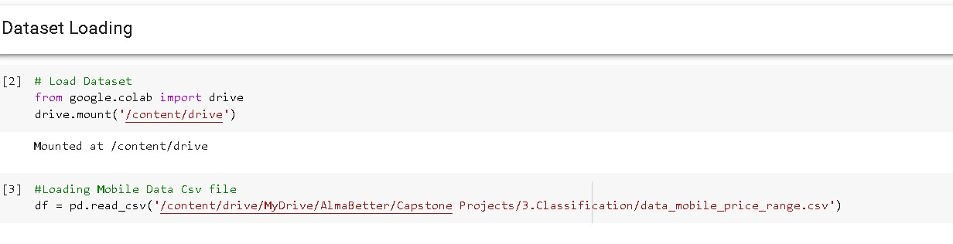
Import Libraries And Load Data Set

Slide 8
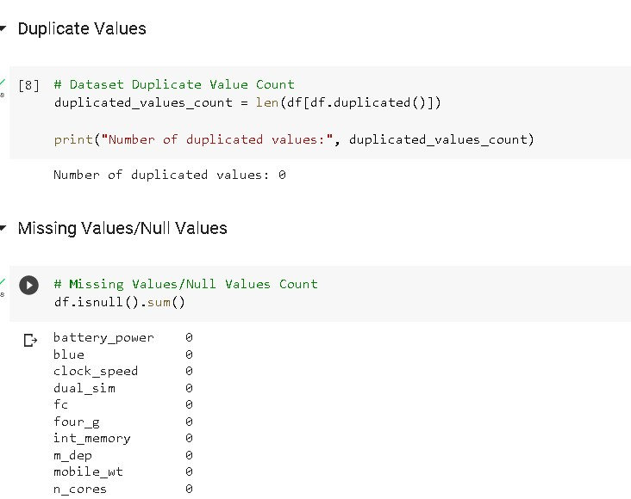
Duplicate Values And Null Values

Slide 9
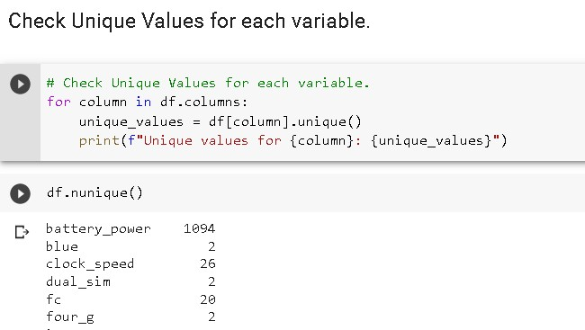
Check Unique Values for each variable.

Slide 10
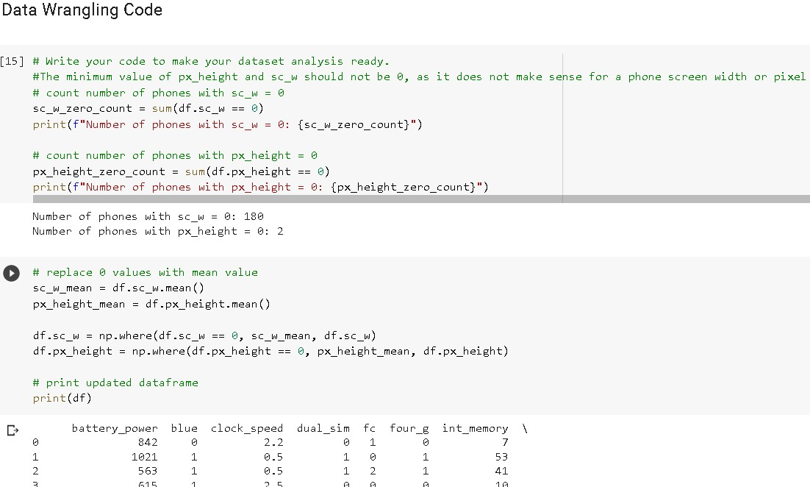
Data Wrangling

Slide 11
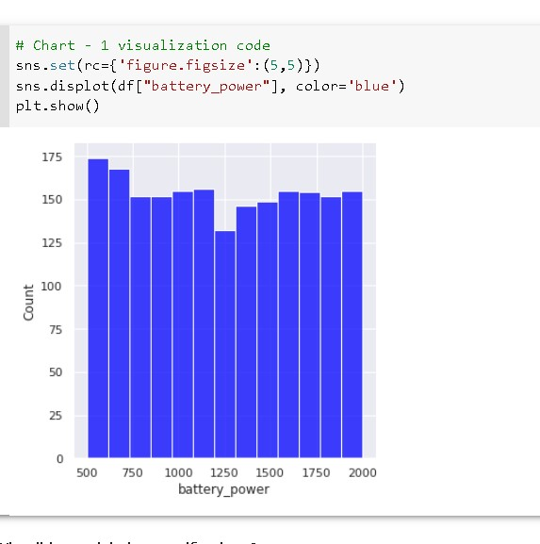
Data Vizualization, Storytelling & Experimenting with charts
Chart - 1
In this the count increasing with battery power or not.
This plot visualizes how the battery capacity, measured in mAh, is distributed across the dataset. We can observe that the distribution of battery capacity is positively correlated with the price range of the mobile phones, as there is a gradual increase in the battery capacity as the price range increases. This suggests that there is a strong relationship between the battery capacity and the price of a mobile phone, and that consumers may be willing to pay more for a mobile phone with a higher battery capacity.

Slide 12
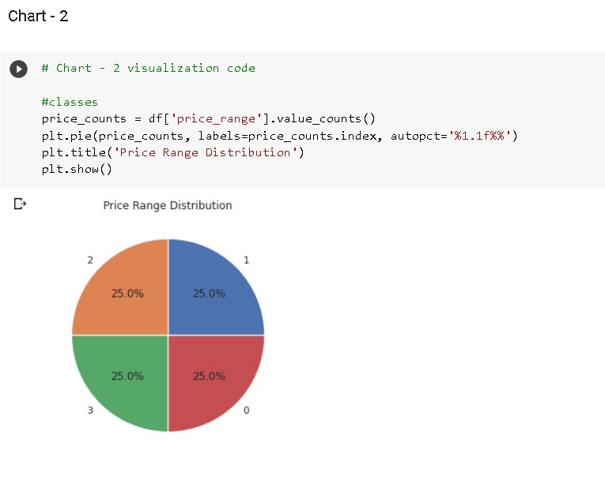
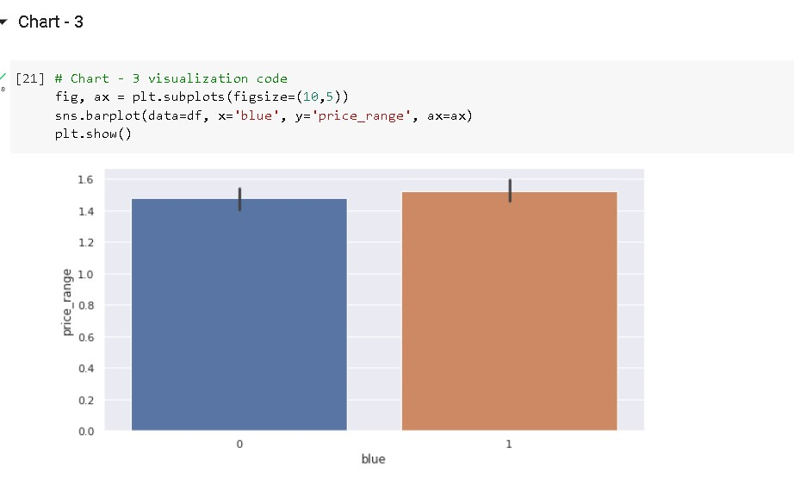
Data Vizualization, Storytelling & Experimenting with charts
Chart – 2 & 3
I picked this chart to know the distribution of percentage of phones with price range low or high.
the devices having bluetooth or not with price range

Slide 13
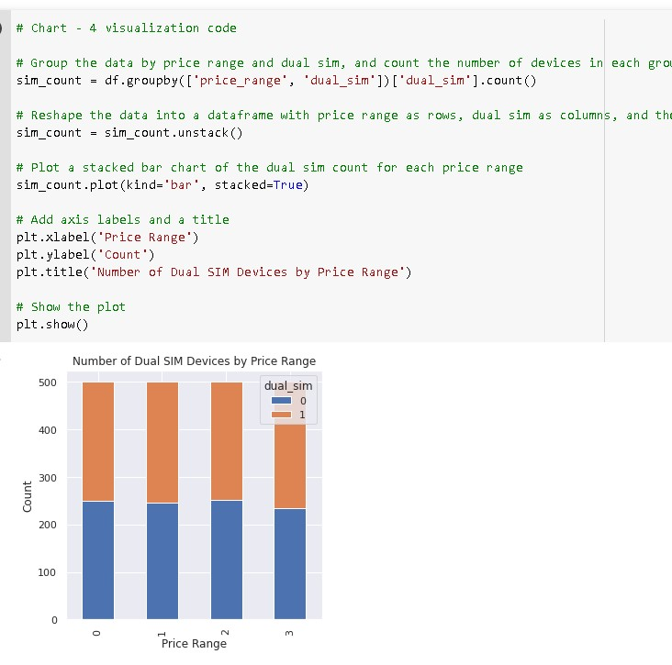
Data Vizualization, Storytelling & Experimenting with charts
Chart - 4
the price range according to dual sim using or not.
We can observe that upto low,medium,high almost it is same but for very high price range it is seen that it is found that the count is raised who using dual devices and count is increasing for dual devices.
it is very useful because we can identify dual sim is actually increasing count or not.It is found that for device containing dual sim

Slide 14
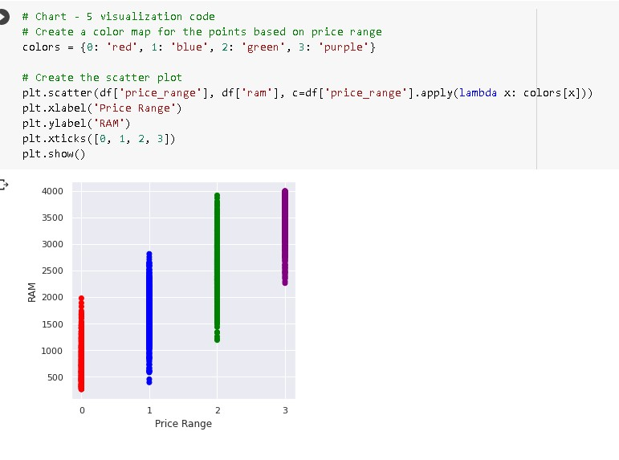
Data Vizualization, Storytelling & Experimenting with charts
Chart - 5
the price relation with ram.
The scatter plot shows a clear positive correlation between RAM and price range, with the majority of the data points clustering towards the upper right corner. This suggests that as the price range increases, the amount of RAM in the device generally increases as well.

Slide 15
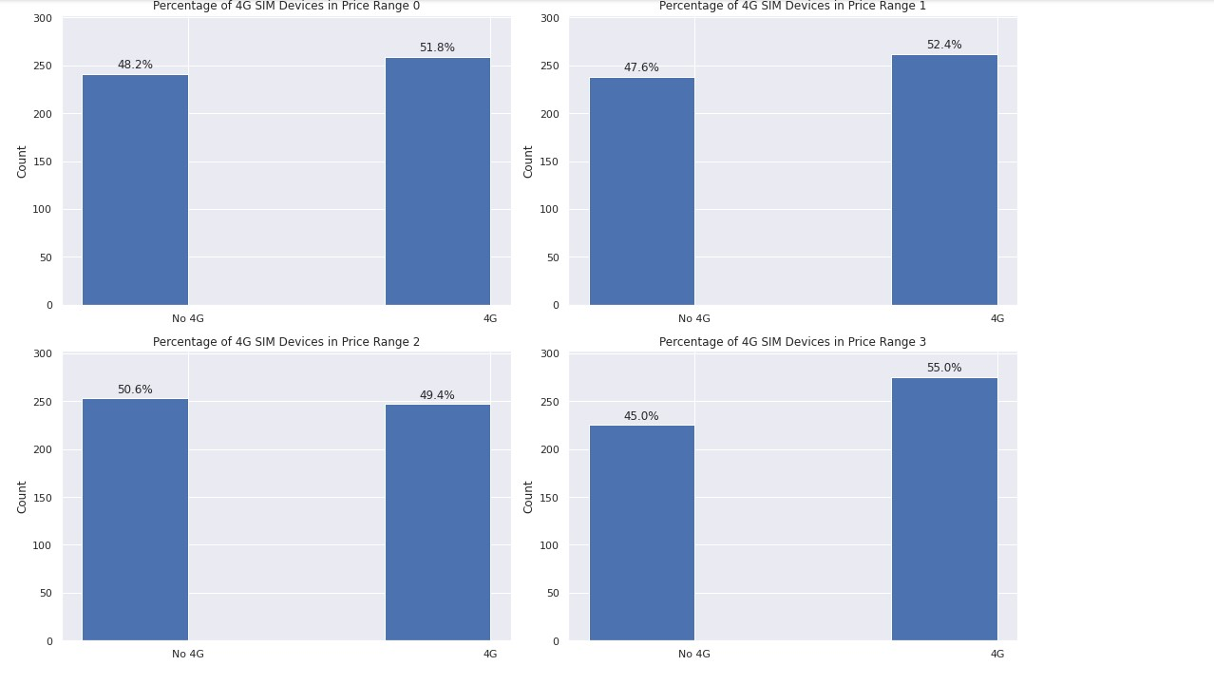
Data Vizualization, Storytelling & Experimenting with charts
Chart - 6
the percentage of 4G sim of mobile phones.
I have found that at low, medium,very high prices the mobile phones having sim in more numbers but at high prices it is showing slightly collapse.
The insights gained from the analysis of the number of SIM cards in mobile phones at different price ranges can be helpful in creating a positive business impact

Slide 16
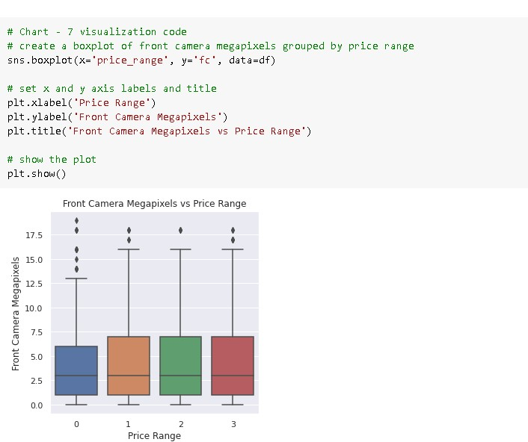
Data Vizualization, Storytelling & Experimenting with charts
Chart - 7
the impact of price range on front camera megapixels.
It is almost same impcact of price range in all categories.
The observation that the distribution of front camera megapixels is similar across all price ranges suggests that this feature alone may not be a helpful predictor of price range. However, this does not necessarily mean that the insights gained from this analysis cannot create a positive business impact.

Slide 17
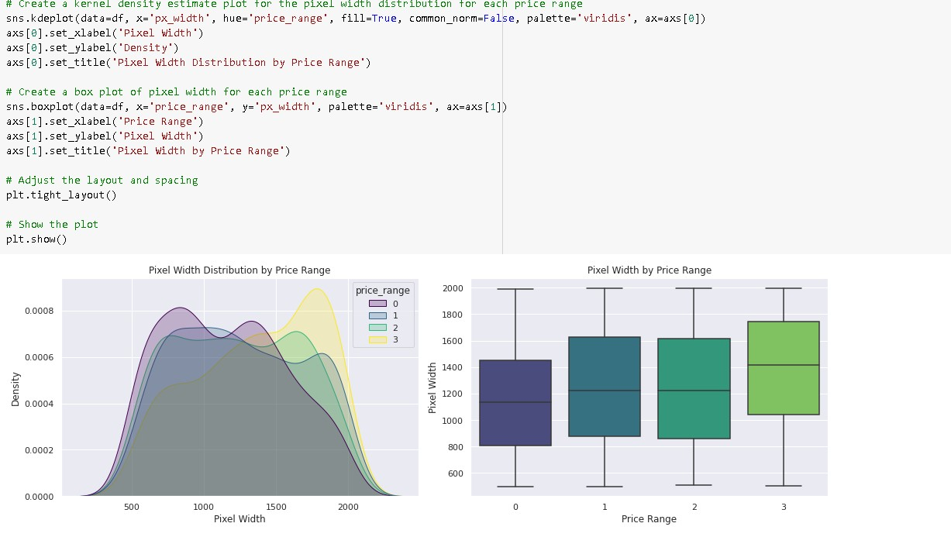
Data Vizualization, Storytelling & Experimenting with charts
Chart - 8
the pixel width on the price range.
Based on the analysis of the pixel width distribution across different price ranges, it can be observed that there is not a continuous increase in pixel width as we move from low cost to very high cost mobile phones.

Slide 18
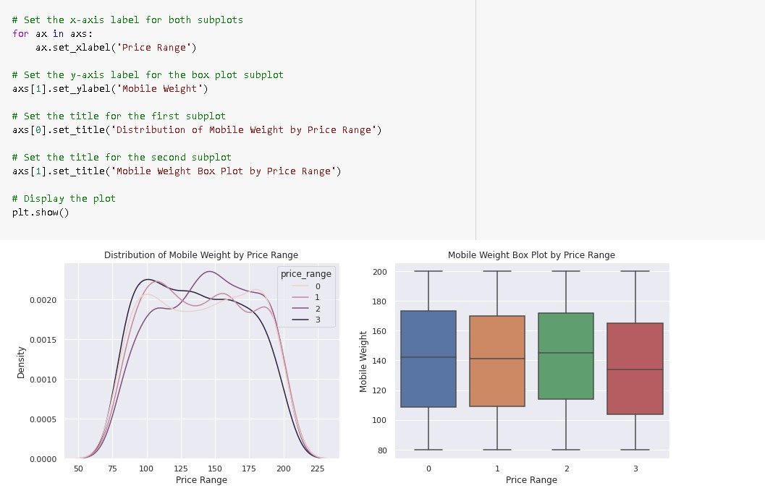
Data Vizualization, Storytelling & Experimenting with charts
Chart - 9
the distribution of mobile weight by price range and mobile weight with respect to price range.
It can be observed that mobile phones with higher price ranges tend to be lighter in weight compared to lower price range phones.

Slide 19
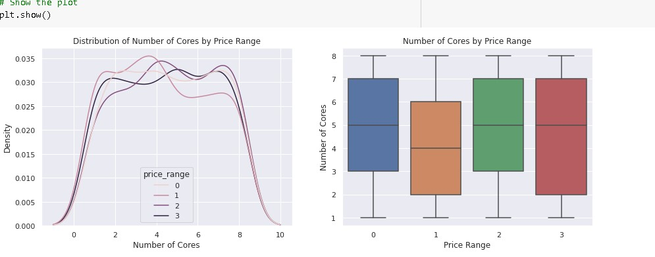
Data Vizualization, Storytelling & Experimenting with charts
Chart - 10
the distribution of number of cores by price range and number of cores by price range.
The distribution of primary camera megapixels across different target categories is relatively consistent, indicating that this feature may not significantly influence the price range of mobile phones. This consistency is a positive sign for prediction modeling, as it suggests that this feature may not be a major confounding factor in predicting the price range.

Slide 20
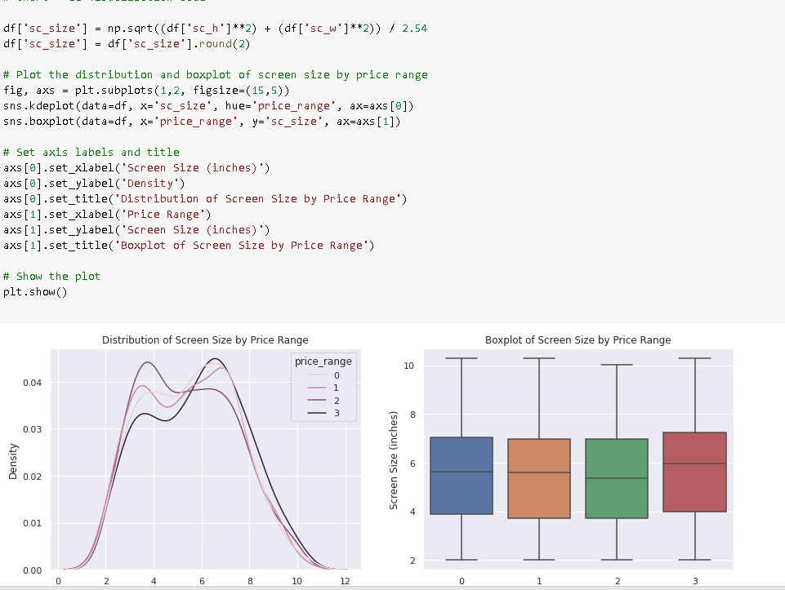
Data Vizualization, Storytelling & Experimenting with charts
Chart - 11
the distribution of screensize by price range and price range respect to screen size.
The analysis of the Screen Size distribution among different target categories indicates that there is not a significant difference in the distribution, suggesting that Screen Size may not be the sole driving factor in determining the target categories.

Slide 21
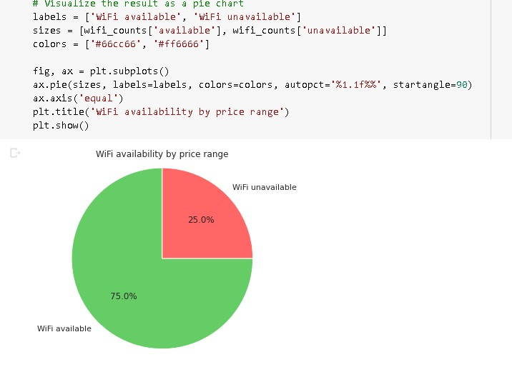
Data Vizualization, Storytelling & Experimenting with charts
Chart - 12
the wifi avilable in how much percentage in mobile phones.
Around in 25% the wifi is not available and in 75% the wifi is available.
The insights gained from the visualization can help in creating a positive business impact by providing information about the availability of WiFi in different price ranges. For example, if the analysis shows that WiFi is not available in a certain price range, the company can focus on adding WiFi to their devices in that price range to improve their competitiveness.

Slide 22
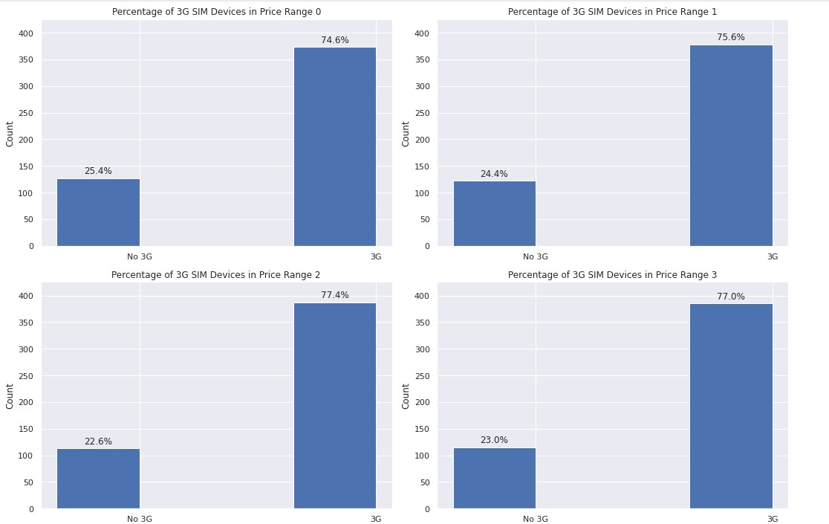
Data Vizualization, Storytelling & Experimenting with charts
Chart - 13
the percentage of 3G sims in all of price range.
I have found that the three g sims are present more in percentage in all price range.
The insight that three-g SIMs are present more in all price ranges could potentially have a positive business impact for companies that manufacture or sell mobile devices.

Slide 23
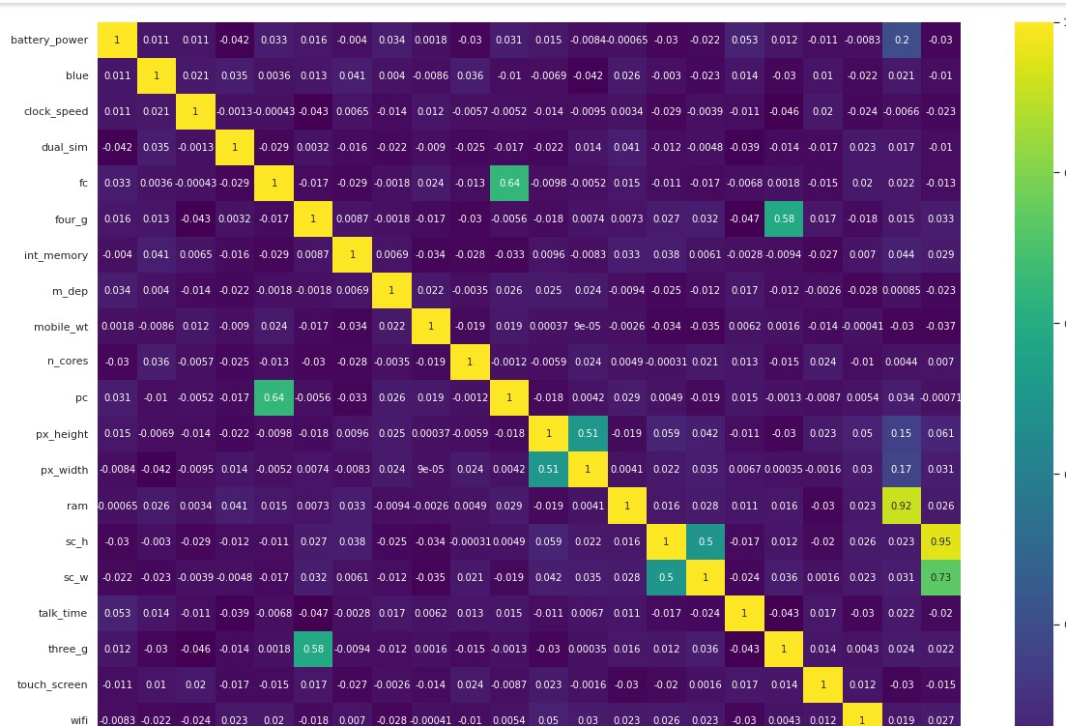
Data Vizualization, Storytelling & Experimenting with charts
Chart - 14
To check the multi-collinearity.
The high correlation between RAM and price_range is a positive sign for businesses as it indicates that RAM will be a major deciding factor in estimating the price range of a mobile phone.

Slide 24
Hypothesis Testing
In the hypothesis testing example where we tested the statement "All category phones are distributed with equal price range", we used the Chi-square goodness-of-fit test to obtain the p-value. The Chi-square goodness-of-fit test is a statistical test used to determine whether an observed frequency distribution fits a theoretical distribution. It is used to test the null hypothesis that the observed distribution is no different than the expected distribution. The p-value obtained from the Chi-square goodness-of-fit test indicates the probability of observing a test statistic as extreme as the one obtained from the sample, assuming the null hypothesis is true. A p-value less than the significance level (usually 0.05) indicates that we reject the null hypothesis and conclude that the observed distribution is significantly different than the expected distribution. A p-value greater than or equal to the significance level indicates that we fail to reject the null hypothesis and conclude that the observed distribution is not significantly different than the expected distribution.

Slide 25
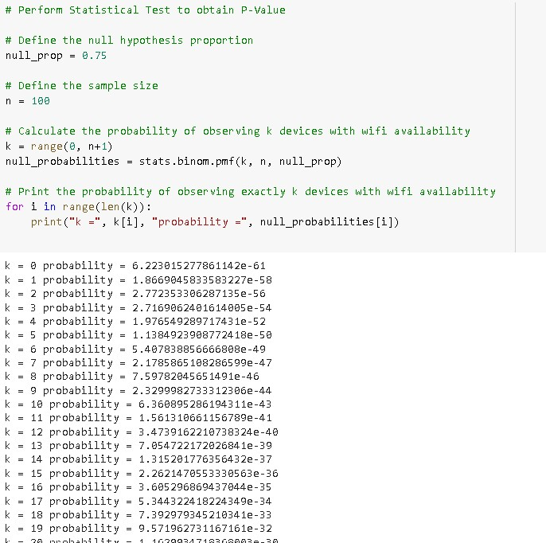
Hypothesis Testing
The statistical test that was used to obtain the p-value is the one-sample proportion test. This test is used to compare a sample proportion to a known population proportion, and determine whether the difference between the two proportions is statistically significant.
the one-sample proportion test was a suitable statistical test to use in this case, as it allowed us to test the research hypothesis and answer the research question using the available data..

Slide 26
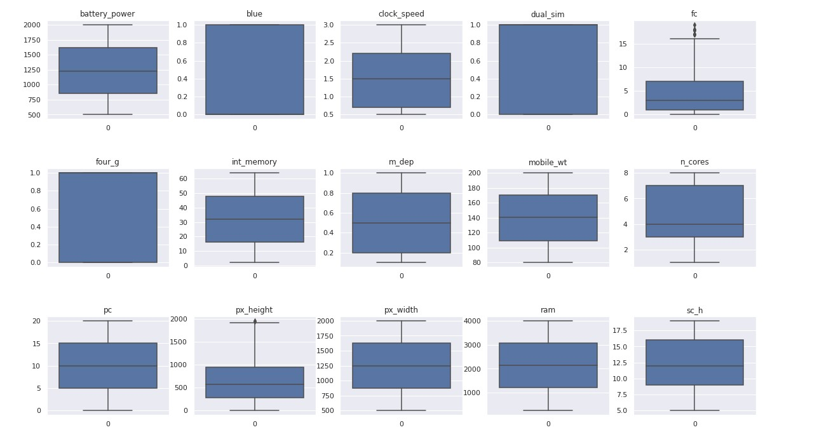
Feature Engineering & Data Pre-processing

Slide 27
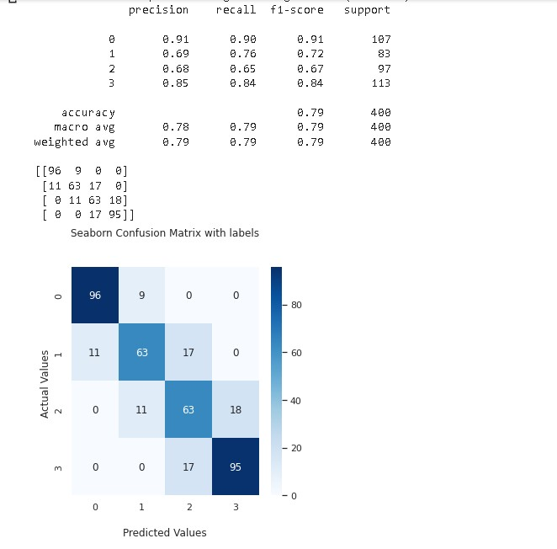
ML Model Implementation
ML_MODEL - 1
The ML model used is a Logistic Regression model. The classification report shows the precision, recall, and F1-score for each class, as well as the support (number of instances) for each class in the training set.
The precision is the ratio of true positive predictions to the total number of positive predictions. The recall is the ratio of true positive predictions to the total number of actual positive instances in the dataset. The F1-score is the harmonic mean of precision and recall.

Slide 28
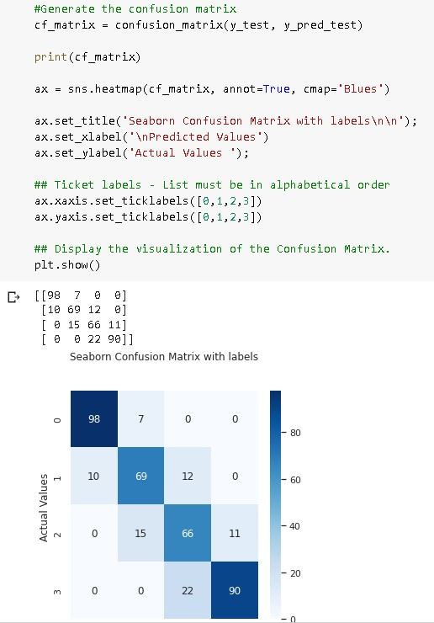
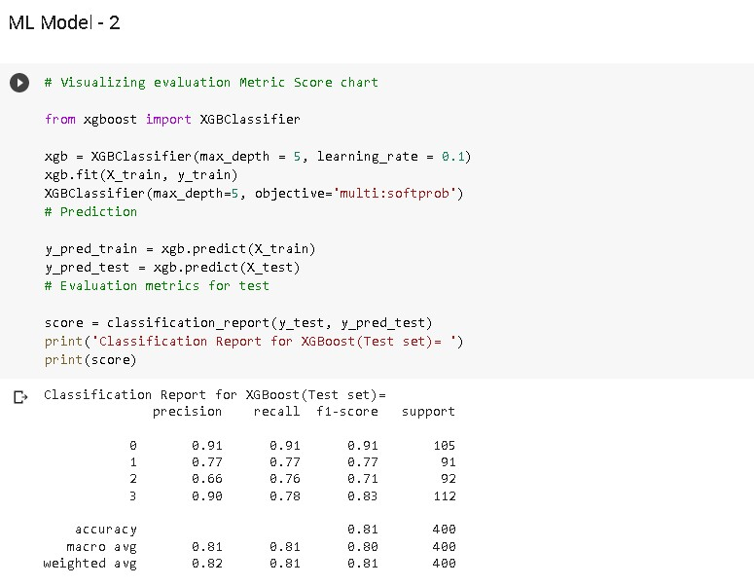
ML Model Implementation
ML_MODEL - 2

Slide 29
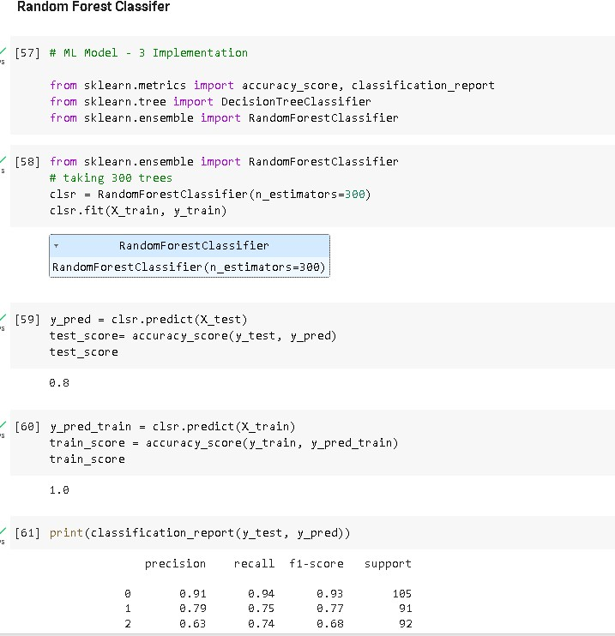
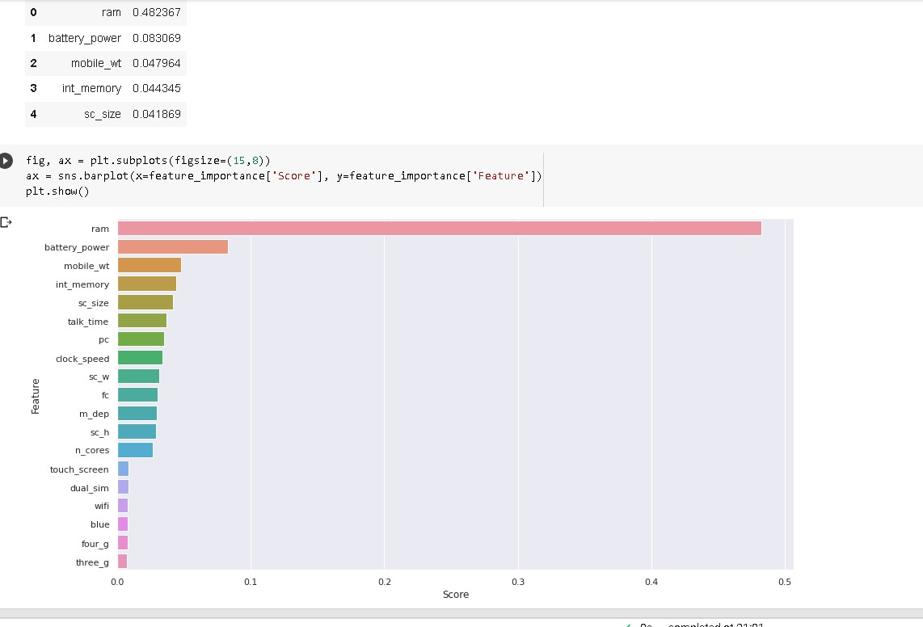
ML Model Implementation
ML_MODEL - 3

Slide 30
I have used GridSearchCV hyperparameter optimization technique. GridSearchCV is a commonly used technique for hyperparameter tuning. It performs an exhaustive search over specified hyperparameter values for an estimator, and evaluates each combination using cross-validation. GridSearchCV helps to automate the process of parameter tuning, and helps to find the best combination of hyperparameters for the model, which in turn can improve its performance.
Yes, there is an improvement in the overall performance of the model. The accuracy has increased from 0.80 to 0.81, and the weighted average F1-score has also increased from 0.80 to 0.81. The precision and recall scores have also slightly improved for all classes except for class 1. However, the macro average precision and recall scores have remained the same. Overall, the model has shown a slight improvement in its performance.

Slide 31
Conclusion
Based on the exploratory data analysis (EDA), we observed that the mobile phones in the dataset are divided into four different price ranges, each having a similar number of elements. Additionally, we found that approximately half of the devices have Bluetooth, while the other half do not. Furthermore, we noted that as the price range increases, there is a gradual increase in battery power, and RAM shows continuous growth from low-cost to very high-cost phones. Moreover, the costly phones tend to be lighter than the lower-priced ones.
Our analysis indicates that RAM, battery power, and pixel quality are the most significant factors affecting the price range of mobile phones. From our experiments, we concluded that logistic regression and XGBoost algorithms with hyperparameter tuning yielded the best results in predicting the price range of mobile phones.
In summary, the EDA revealed that the dataset consists of mobile phones grouped into four price ranges, with similar numbers of devices in each range, and a 50-50 distribution of Bluetooth. We also observed that RAM and battery power increase with the price range, and higher-priced phones tend to be lighter. Our experiments suggest that the most important factors affecting the price range of mobile phones are RAM, battery power, and pixel quality. Finally, we found that logistic regression and XGBoost algorithms, coupled with hyperparameter tuning, provide the best performance in predicting the price range of mobile phones.

Slide 32


